Slide 1
VLSI DESIGN
LECTURE 10
BE(ECE)5TH SEMESTER

Slide 2
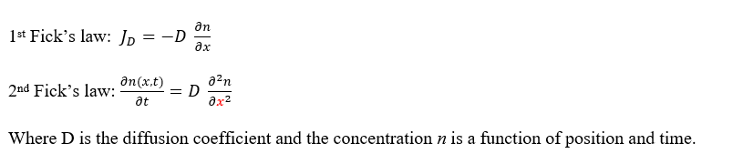
Diffusion of Dopant Impurities
Fick’s Laws Governing Diffusion Process
The diffusion rate of impurities into semiconductor lattice depends on the following:
Mechanism of diffusion
Temperature
Physical properties of impurity
The properties of lattice environment
The concentration gradient of impurities
The geometry of parent semiconductor

Slide 3
The change of solute concentration with time must be the same as the local decrease of the diffusion flux, in the absence of a source or a sink. This follows from the law of conservation of matter. Therefore we can write down the following equation
∂N(x,t)/∂t = -∂F(x,t)/∂x
Substituting the above equation to ‘F’. We get
∂N(x,t)/∂t = ∂/∂x[D*∂N(x,t)/∂x]
When the concentration of the solute is low, the diffusion constant at a given temperature can be considered as a constant.
Thus the equation becomes,
∂N(x,t)/∂t = D[∂²N(x,t)/∂x²]
This is Ficks second law of distribution.

Slide 4
Parameters and properties of Diffusion
Parameters which affect diffusion profile:
Solid solubility
Diffusion temperature
Diffusion time
Surface cleanliness and defects in silicon crystal

Slide 5
Properties of Diffusion Process:
(Dt)eff = D1t1 + D2t2 + D3t3 +.....
Lateral diffusion effects
The dopant selection affects IC characteristics.
=

Slide 6
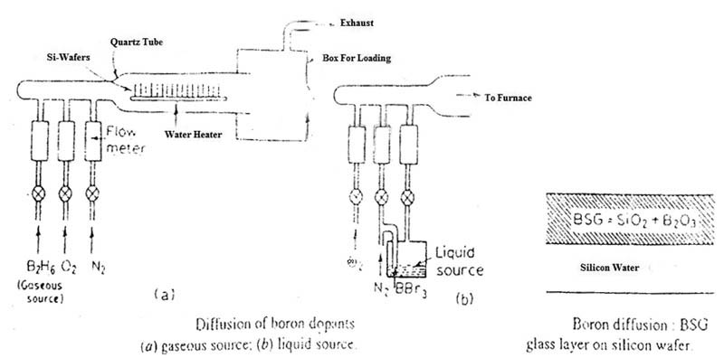
Diffusion Of p-Type Impurity
Boron Diffusion using B₂H₆ (Diborane) Source
Si + O₂ = SiO₂ (silica glass)
2B₂H₆ + 3O₂ = B₂O₃ (boron glass) + 6H₂
Boron Diffusion using BBr₃i (Boron Tribromide) Source
4BBr₃ + 3O₂ = B2O₃ + 2Br₂

Slide 7
Diffusion of n-Type Impurity
Phosphorous diffusion using phosphorous oxychloride
Si + O2 = SiO2 (silica glass)
4POCl + 3₂ = 2P₂0₅ + 6Cl₂

Slide 8
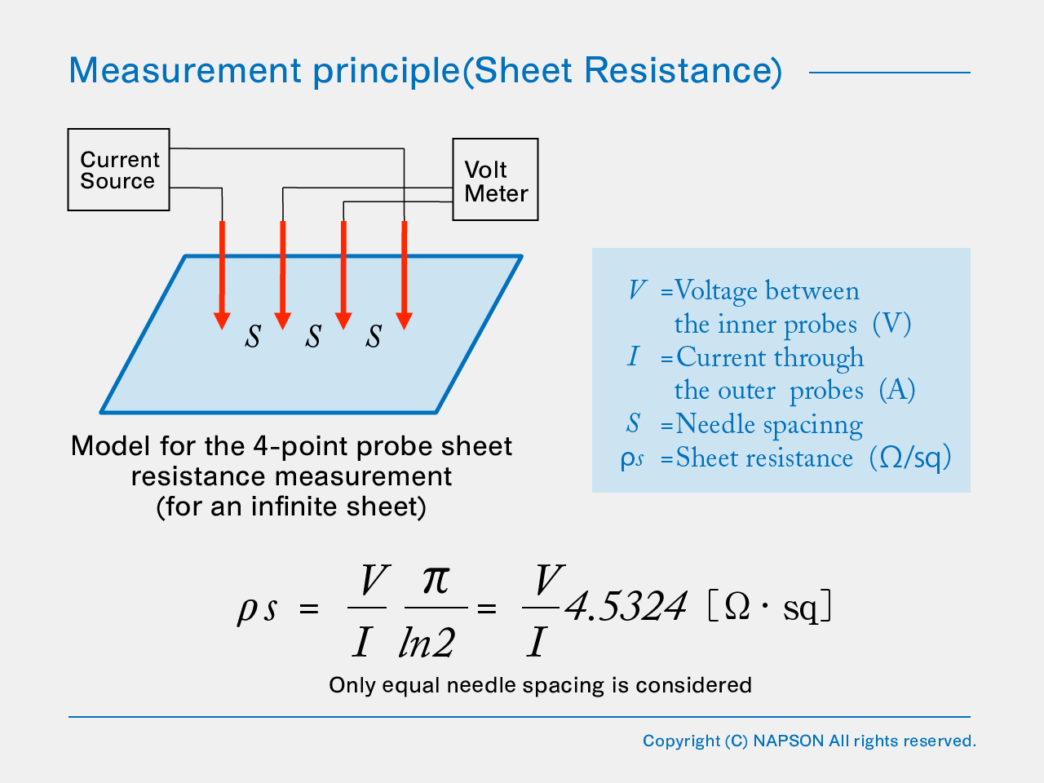
Characterization of Diffused layers

